Slide 1
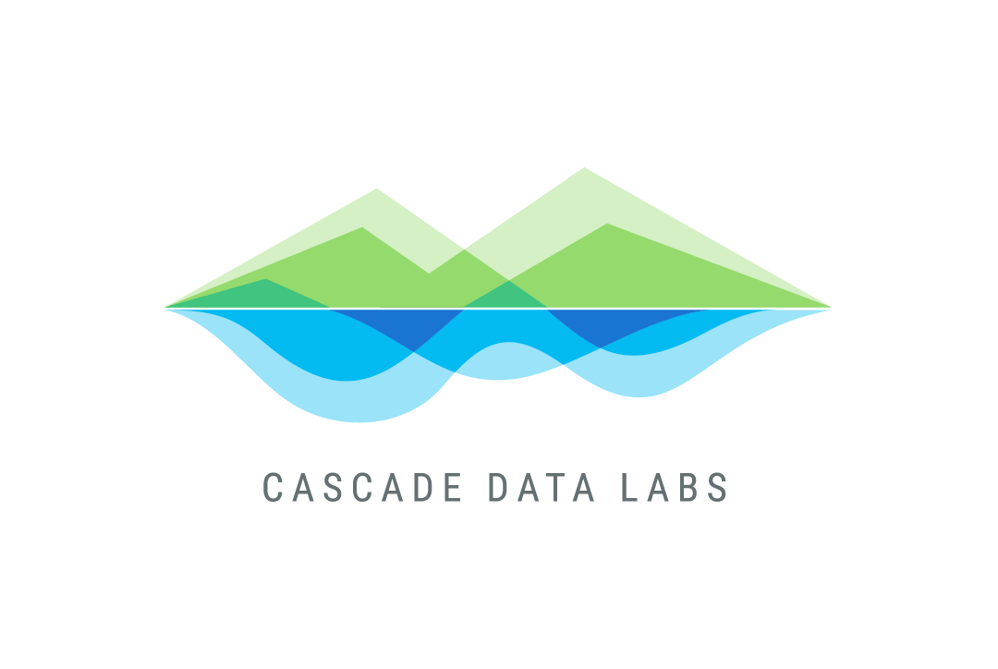
STATEFUL DISTRIBUTED COMPUTING
WITH RAY
Tom Baldwin
Data Scientist
PyData PDX
October 7, 2020

Slide 2


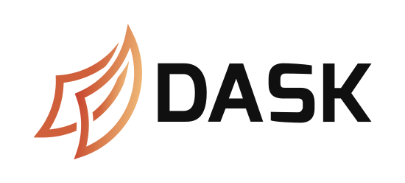

DISTRIBUTED COMPUTING FRAMEWORKS
Tools for running your code on multiple computers.
Head
Node
Enterprisey!
Worker
Nodes
The Python native:
This talk:

Slide 3
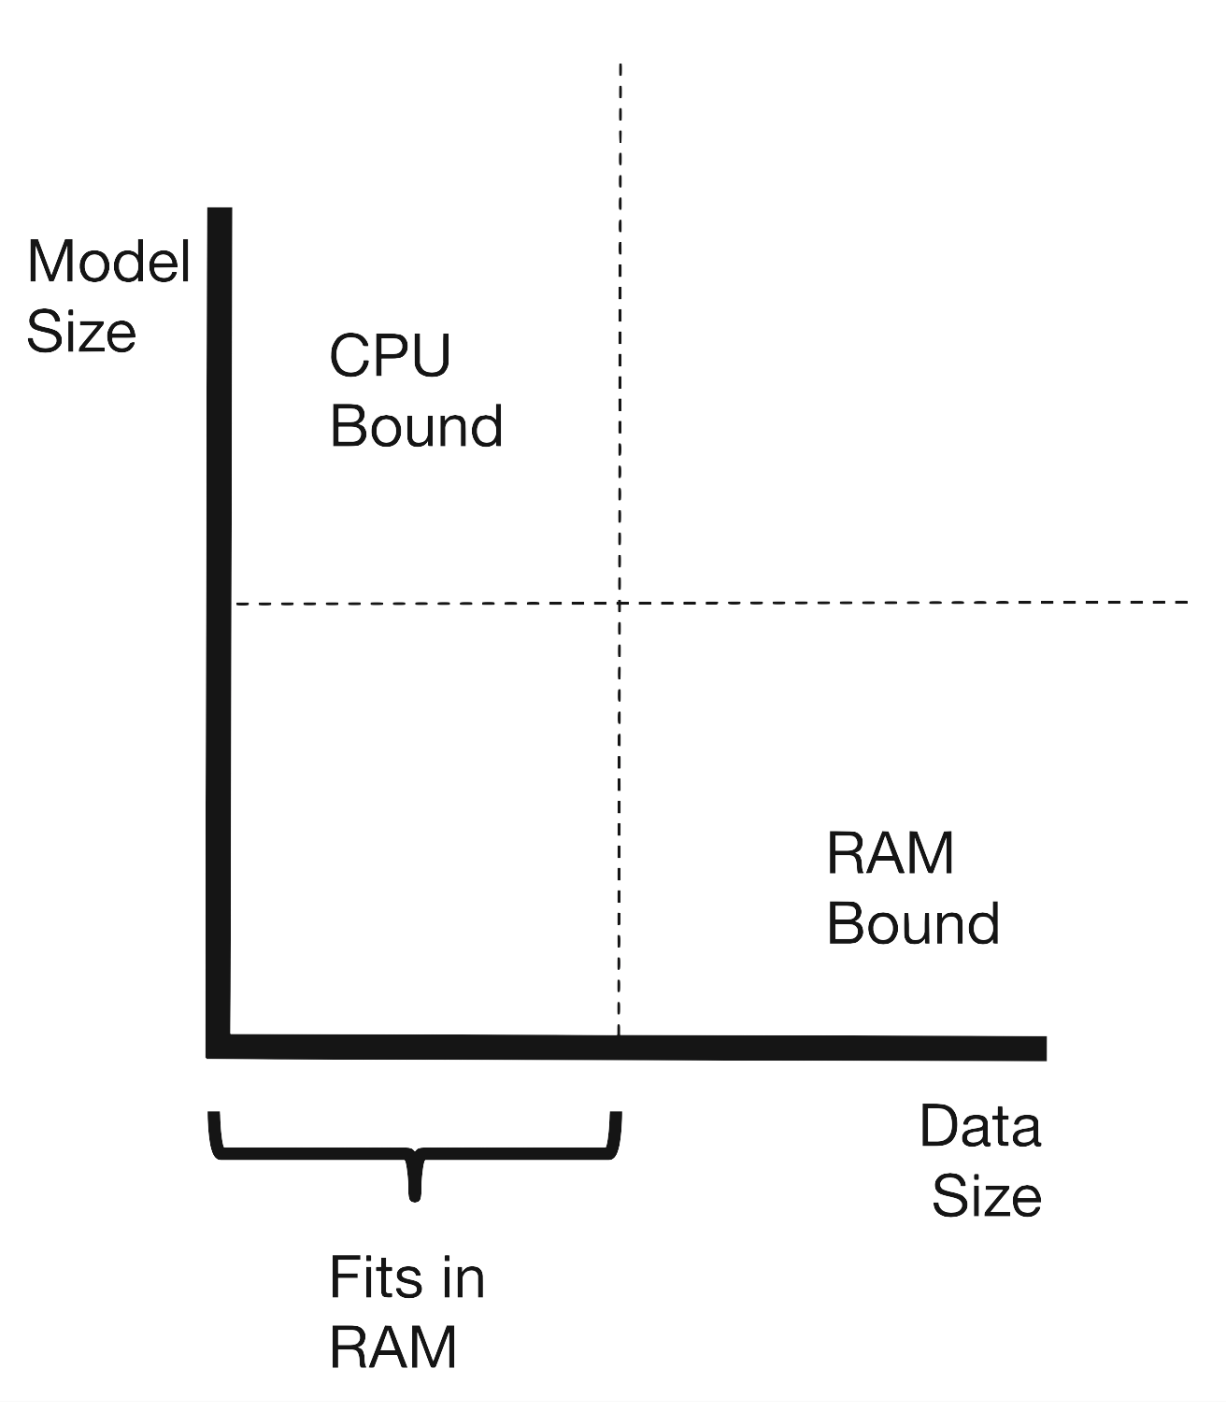
WHEN TO USE DISTRIBUTED COMPUTING
Memory bound
Dataset is too big
Each computer gets a portion
CPU bound
“Embarrassingly parallel” operations can be divided into independent parts
Each computer does some tasks
See: Tom Augspurger’s talk at PyData NYC 2019 (video) (slides)

Slide 4
@F.udf(T.LongType())
def my_func(x):
time.sleep(1)
return x * 2
@dask.delayed
def my_func(x):
time.sleep(1)
return x * 2
@ray.remote
def my_func(x):
time.sleep(1)
return x * 2
# spark
[row[0] for row in df.select(my_func(F.col("col"))).collect()]
# dask
dask.compute([my_func(i) for i in range(4)])
# ray
ray.get([my_func.remote(i) for i in range(4)])

Slide 5
The decorator takes your custom function and replaces it with one that:
Pickles your code
Pickles any arguments passed to it
Ships code + args off to an idle computer somewhere (a worker node), which runs it
Returns a reference to a task in progress
That can be traded for the real result when you call compute() (or get() or…)
@decorator
def my_function(x):
# ... very serious business ...
return result
@decorator
def MyClass(x):
def my_method(self, x):
# very serious business
# using internal state
return result
Ray can also do this with classes.

Slide 6
THE STATEFUL WORKER ABSTRACTION
In Ray, you can
Decorate & call a function to create a task
Decorate & instantiate a class to create an actor
Actors are like tasks (your code on a remote node) that hang around until you explicitly stop them.
While an actor is active, you can call its methods to trigger computations and manipulate its internal state.
Dask can also do this (via experimental API)

Slide 7

actor_a = MyActor.remote(coef=2)
actor_b = MyActor.remote(coef=5)
ray.get(
[
actor_a.my_method.remote(x=2),
actor_b.my_method.remote(x=2),
]
) # [4, 10]
@ray.remote
class MyActor(object):
def __init__(self, coef=2):
self.coef = coef
def set_coef(self, coef):
self.coef = coef
def my_method(self, x):
time.sleep(1)
return x * self.coef
ray.get(actor_b.set_coef.remote(coef=3))
ray.get(
[
actor_a.my_method.remote(x=2),
actor_b.my_method.remote(x=2),
]
) # [4, 6]

Slide 8


Task Abstraction
Actor Abstraction
Head
Node
Worker
Node
Head
Node
Worker
Node
Initialize
Store state in instance attributes
Call Function
Call method
Local variables disappear on exit
Return result
Return result
Call Method
Call Method
Return Result
Return Result

Slide 9
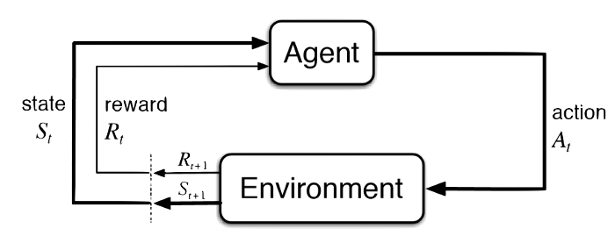
REINFORCEMENT LEARNING
ML paradigm in which an agent interacts with an environment, seeking to maximize some reward
Agents contain a model which they can update/retrain in response to feedback from actions taken
RL algorithms succeed or fail based on
How well the model fits
How well they balance explore/exploit
context
Diagram from Towards Data Science

Slide 10
@ray.remote
class LearningAgent(object):
def __init__(self, training_data):
self.training_data = training_data
self.model = MyFancyModel()
self.model.fit(training_data)
def make_prediction(self, context):
action = self.model.predict(context)
return action
def receive_feedback(self, context, action, reward):
self.training_data.append([context, action, reward])
self.model.retrain(self.training_data)
context
Using actors for RL avoids pickling/unpickling the model on each cycle.

Slide 11


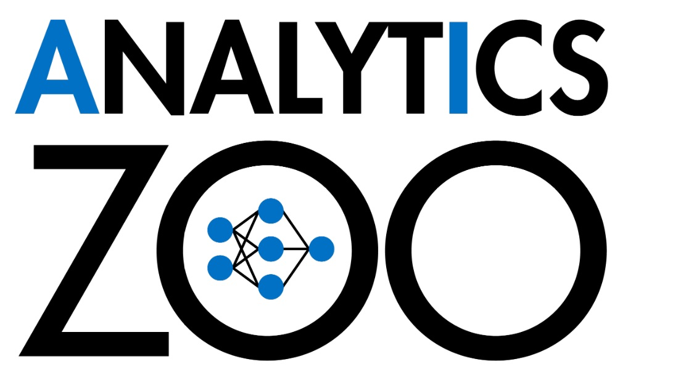
PROJECTS RELATED TO RAY
Bundled with Ray
Tune (for hyperparameter tuning)
RLlib (for reinforcement learning)
External projects
RayOnSpark (Analytics Zoo)

Slide 12
THINGS TO LIKE ABOUT RAY
First-class support for the stateful worker (actor) abstraction
Experimental support in Dask
Pretty easy to set up
Can run on local computer or on a cluster
I even made a toy cluster out of two laptops!
Scales up to running on cloud clusters
Built-in toolkits for RL and HPT
You might not need it if:
Your problem is memory-bound (use a Spark or Dask dataframe)
Your distributed CPU-bound problem doesn’t require keeping state
You might not need distributed computing at all!
https://ray.io

Slide 13
cascadedatalabs.com

